Slide 1
Nervous System

Slide 2
Nervous System:
The nervous system is the control centre of our body or it can be taught as the body’s communication system. It regularly receives records and passes on information. It receives information from the environment and from different parts of our body. It records this information and sends messages to different parts of the body, ordering them to perform certain functions.
Organs of Nervous System:
The Brain
The Spinal Cord
The Nerves

Slide 3
The Brain: The brain is an important part of nervous system. It is very complex and delicate organ of our body, which is protected by the bony skull. It weight approximately 1420 grams. The main parts of the brain are:-
The cerebrum
The diencephalon
The cerebellum
The medulla oblongata
The cerebrum: The cerebrum is the major part of the brain. The outer portion of the cerebrum or cortex is the site of the mind and intelligence. It is also called the gray matter. This is our conscious brain. It allows us to think, feel, and decide our movements. It governs the whole body.

Slide 4
The Diencephalon: This part of the brain consists of thalamus and hypothalamus. The thalamus is an important sensory (information receiving) center. All sensory inputs except smell enter the thalamus and sent to the concerned area of gray matter. The hypothalamus is a smell area directly below the thalamus but functionally it is a vast area of the brain. It functions as a link between the mind (psycho) and the body (somato).

Slide 5
The Cerebellum: The cerebellum is located under the back lobes of the cerebrum and partially covered by it. It is the second largest part of the brain. It is connected to many parts of the brain and has important role in coordinating movements. It helps us in controlling our muscle movements, balance and equilibrium.
The Medulla Oblongata: The medulla oblongata is composed of the mid brain and nerve fibres of our brain and connecting the brain and the spinal cord. All sensory and motor nerve passes through the medulla oblongata as they relay information between the brain and the spinal cord. The medulla has centres, which control the heart and lungs. When the medulla is injured, death results, the heart and lungs stop beating and breathing respectively.

Slide 6
The Spinal Cord: The spinal cord forms the main link between the brain and the rest of the body. It is attached to the medulla and runs down the middle of the back. The spinal cord carries both sensory and motor fibres between the brain and other parts of the body. It is protected by the vertebrae of the backbone. Nerves branch out from the spinal cord to all parts of the body. Messages travel from the brain, down the spinal cord, through the nerves (motor nerve) to all parts of the body. Incoming messages from all parts of the body enter the spinal cord through the nerves (sensory nerve) and then travel up to the brain.

Slide 7
The Nerves: The basic unit of nervous system is the nerve cell called neuron, which is found in all parts of the body particularly the brain and the spinal cord. The colour of the nerve is gray. Through neuron, messages are carried between the receptors and effectors.

Slide 8
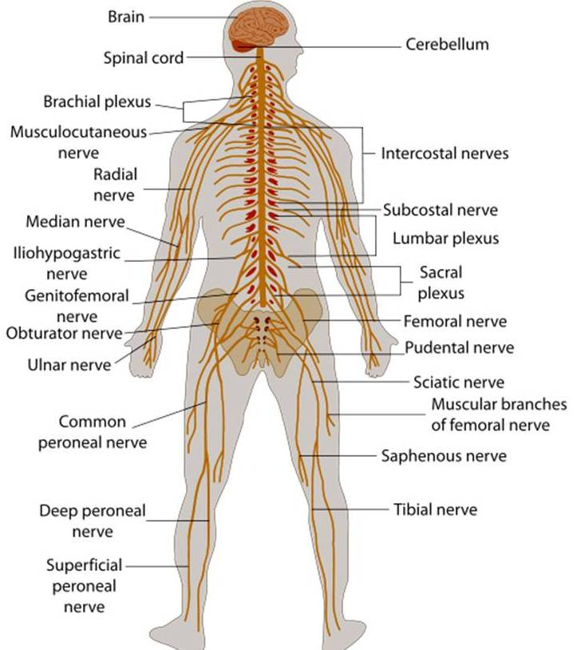

Slide 9
Functions of nervous system:
The Central Nervous System: The central nervous system consists of the centrally located nervous system organs that are the brain and the spinal cord. The central nervous system has more than 100 billions of neurons.
The Autonomic Nervous System: Usually the autonomic nervous system is considered a part of motor division of the peripheral nervous system. But it regulates our body’s involuntary internal functions such as blood pressure, heart rate, blood distribution and respiration. These functions are very important to physical activities and sports.

Slide 10
The Peripheral Nervous system: The peripheral nervous system contains 43 pairs of nerves. 12 pairs of carnial nerves that connect with the brain and 31 pairs of spinal nerves that connects with the spinal cord. The peripheral nervous system can be divided into two major divisions i.e. sensory and motor. The sensory division of peripheral nervous system carries sensory information towards central nervous system. Motor division of our peripheral nervous system carries the information transmitted by the central nervous system to different parts of our body through the motor or efferent. When our CNS has processed the information it receives from the sensory division, it divides how the body should respond to that information.

Slide 11
Thank You
Have A Nice day

